Slide 1
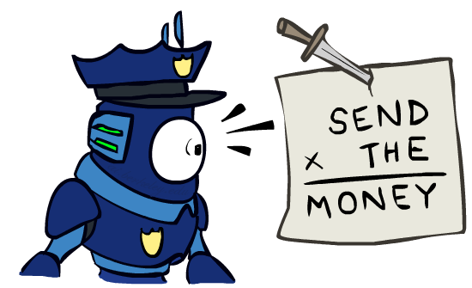
Warm-up: Cryptarithmetic
How would we formulate this as a linear program?
Notes:
0=7, R=4, W=6, U=2, T=8, F=1; 867 + 867 = 1734

Slide 2
Announcements
Assignments:
HW4 (written)
Due Tue 2/12, 10 pm
P2: Optimization
Released after lecture
Due Thu 2/21, 10 pm
Midterm 1 Exam
Mon 2/18, in class
Recitation Fri is a review session
Practice midterm coming soon!

Slide 3
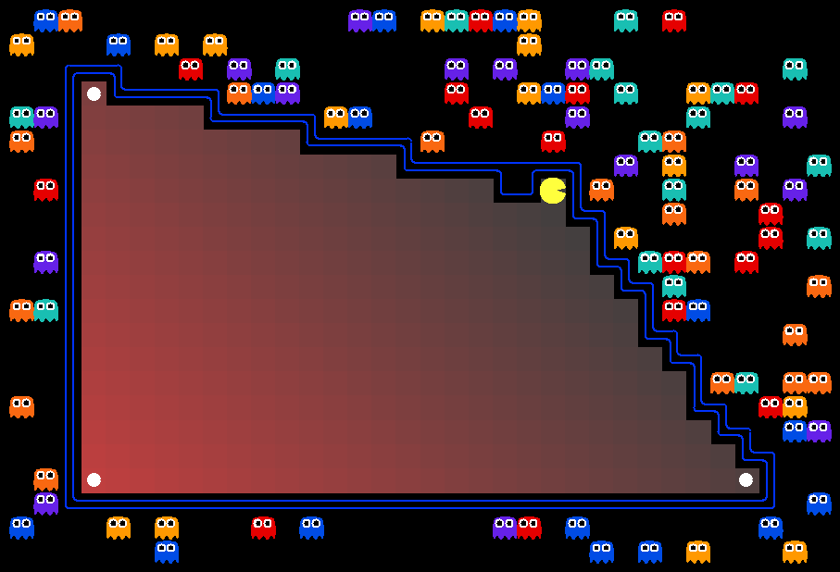
AI: Representation and Problem Solving
Integer Programming
Instructors: Pat Virtue & Stephanie Rosenthal
Slide credits: CMU AI, http://ai.berkeley.edu

Slide 4
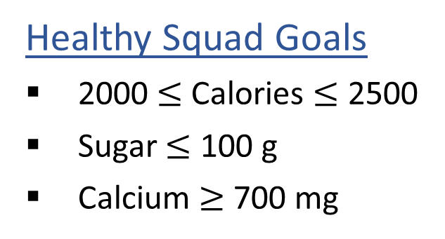
Linear Programming: What to eat?
We are trying healthy by finding the optimal amount of food to purchase.
We can choose the amount of stir-fry (ounce) and boba (fluid ounces).
Healthy Squad Goals
2000 $≤$ Calories $≤$ 2500
Sugar $≤$ 100 g
Calcium $≥$ 700 mg
Food | Cost | Calories | Sugar | Calcium
Stir-fry (per oz) | 1 | 100 | 3 | 20
Boba (per fl oz) | 0.5 | 50 | 4 | 70
What is the cheapest way to stay “healthy” with this menu?
How much stir-fry (ounce) and boba (fluid ounces) should we buy?

Slide 5

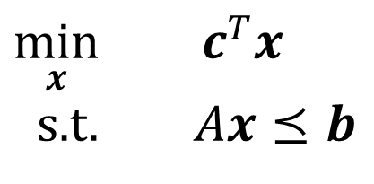

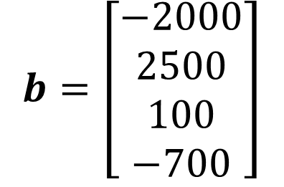
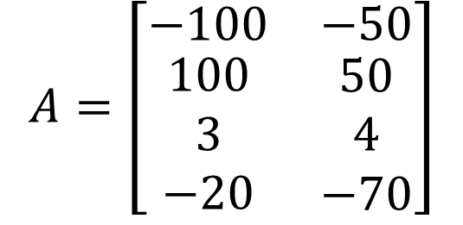
Optimization Formulation
Diet Problem
$\min_{x}{ c^{T}x}$
s.t. $Ax⪯b$
Cost
$$c=\left[\begin{aligned}1 \\ 0.5\end{aligned}\right]$$
Stir-fry
Boba
Limit
$$A=\left[\begin{matrix}−100 & −50 \\ \begin{aligned}100 \\ 3 \\ −20\end{aligned} & \begin{aligned}50 \\ 4 \\ −70\end{aligned}\end{matrix}\right]$$
$$b=\left[\begin{aligned}−2000 \\ 2500 \\ 100 \\ −700\end{aligned}\right]$$
Calorie min
Calorie max
Sugar
Calcium

Slide 6
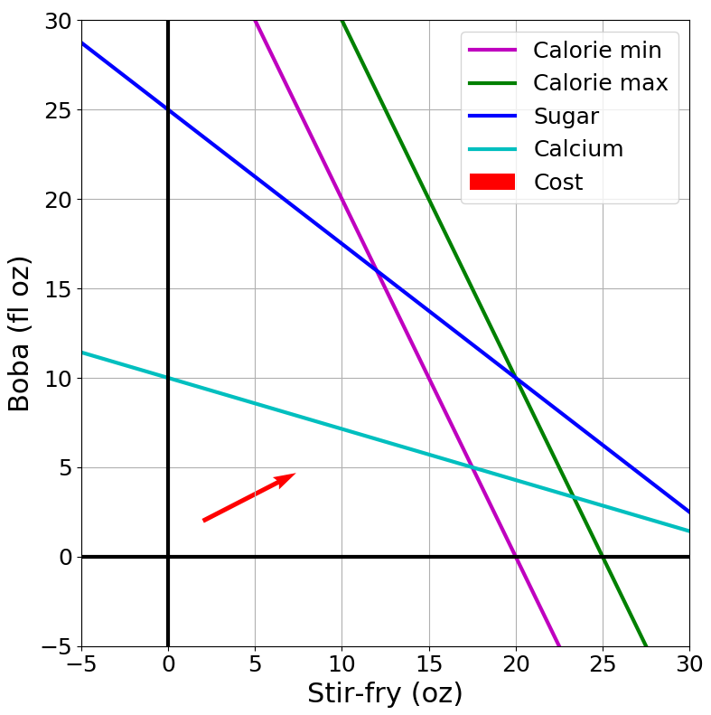
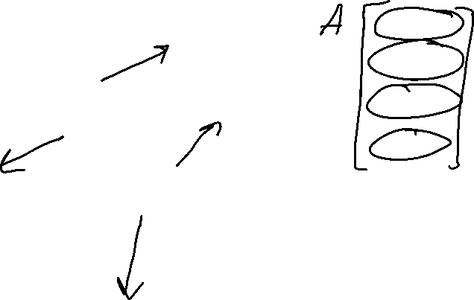

Slide 7
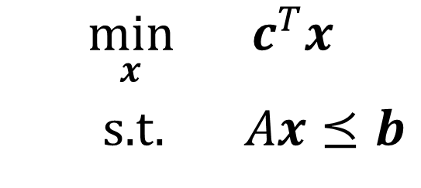
Representation & Problem Solving
Problem Description
Graphical Representation
Optimization Representation
$$\min_{x}{ c^{T}x}$$
s.t. $Ax⪯b$

Slide 8
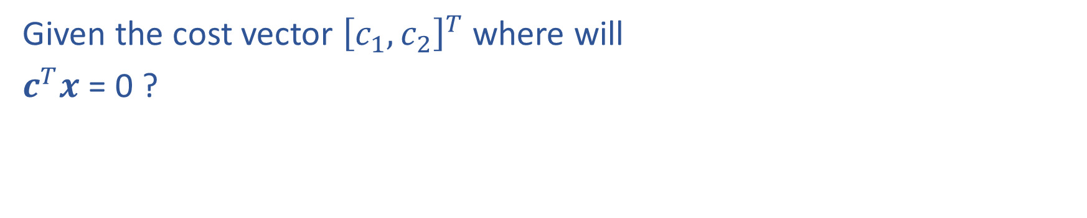
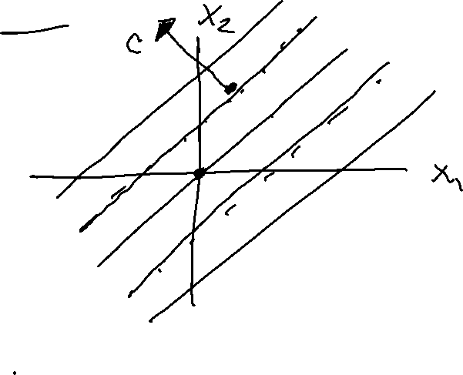
Cost Contours
Given the cost vector ${\left[c_{1}, c_{2}\right]}^{T}$ where will
$c^{T}x$ = 0 ?

Slide 9
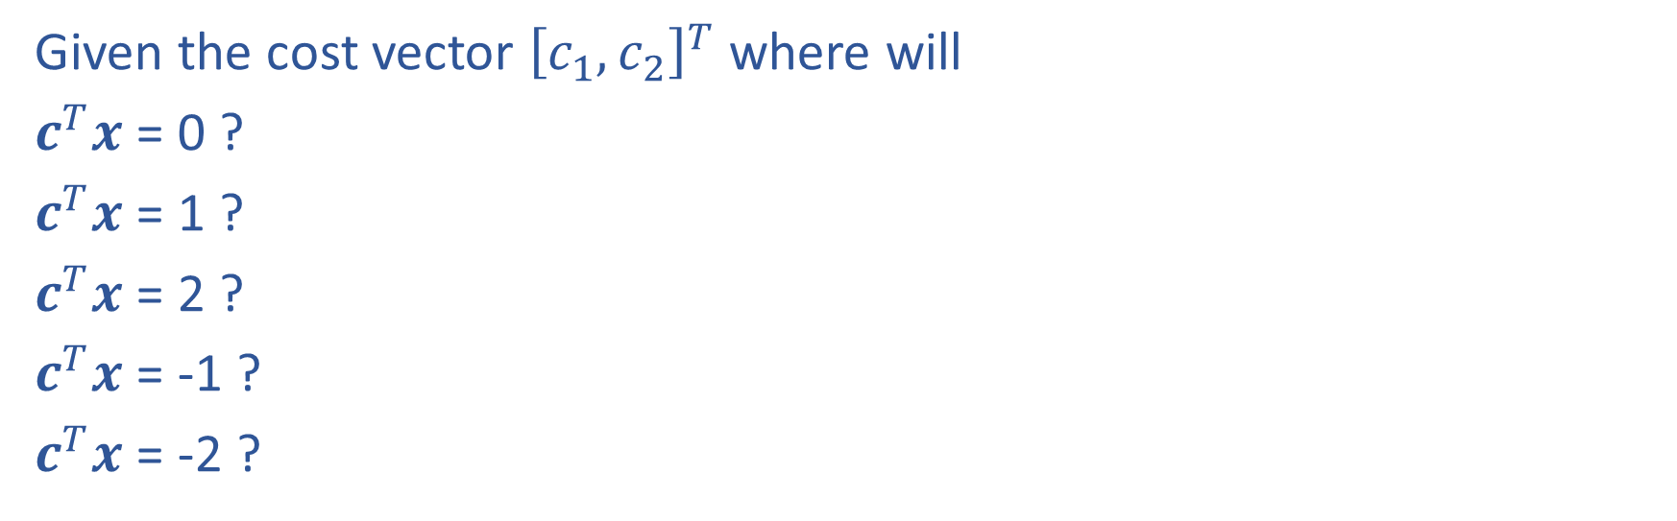
Cost Contours
Given the cost vector ${\left[c_{1}, c_{2}\right]}^{T}$ where will
$c^{T}x$ = 0 ?
$c^{T}x$ = 1 ?
$c^{T}x$ = 2 ?
$c^{T}x$ = -1 ?
$c^{T}x$ = -2 ?

Slide 10

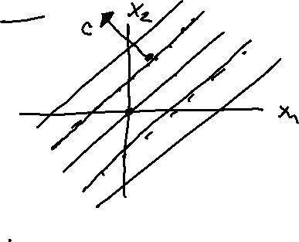
Piazza Poll 1
As the magnitude of $c$ increases, the distance between
the contours lines of the objective $c^{T}x$:
Increases
Decreases

Slide 11
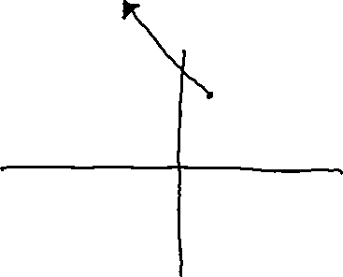

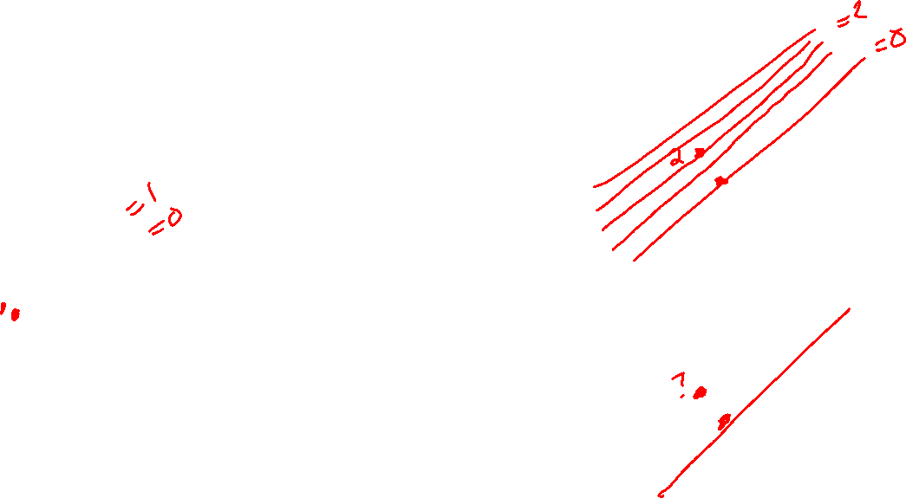
Piazza Poll 1
As the magnitude of $c$ increases, the distance between
the contours lines of the objective $c^{T}x$:
Increases
Decreases

Slide 12
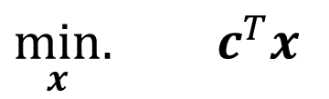
Solving a Linear Program
Inequality form, with no constraints
$\min_{x}.{ c^{T}x}$

Slide 13
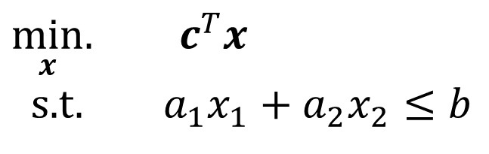
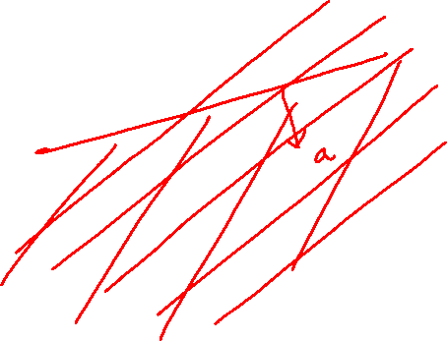
Solving a Linear Program
Inequality form, with no constraints
$\min_{x}.{ c^{T}x}$
s.t. $a_{1}x_{1}+a_{2}x_{2}≤b$

Slide 14
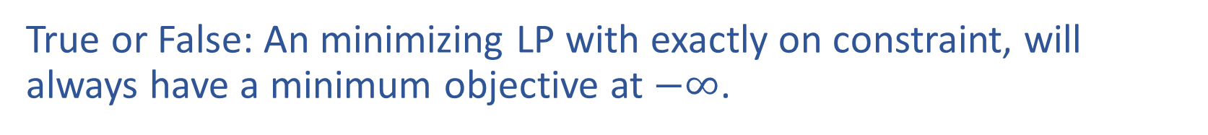
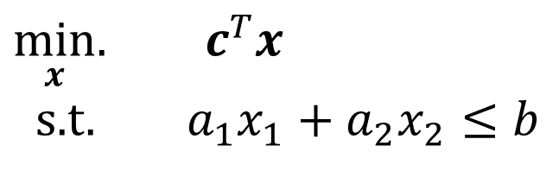
Piazza Poll 2
True or False: An minimizing LP with exactly on constraint, will always have a minimum objective at $−∞$.
$\min_{x}.{ c^{T}x}$
s.t. $a_{1}x_{1}+a_{2}x_{2}≤b$

Slide 15
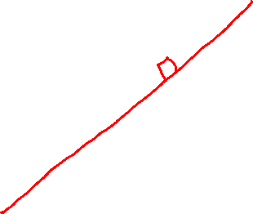

Piazza Poll 2
True or False: An minimizing LP with exactly on constraint, will always have a minimum objective at $−∞$.
$\min_{x}.{ c^{T}x}$
s.t. $a_{1}x_{1}+a_{2}x_{2}≤b$

Slide 16
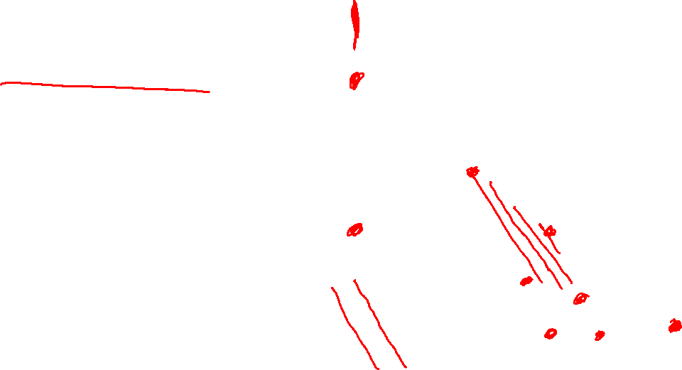
Solving an LP
Solutions are at feasible intersections
of constraint boundaries!!
Algorithms
Check objective at all feasible intersections

Slide 17
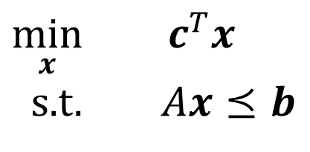
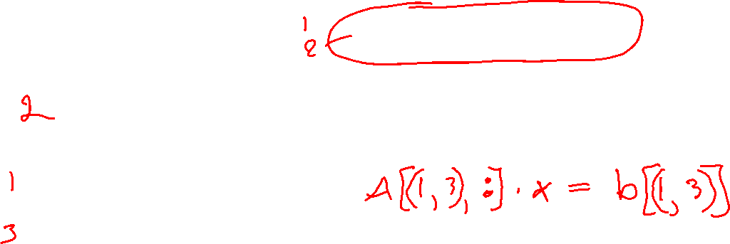
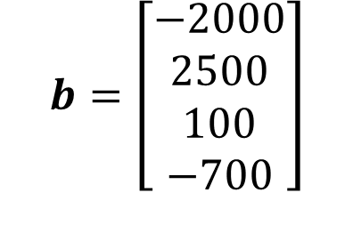
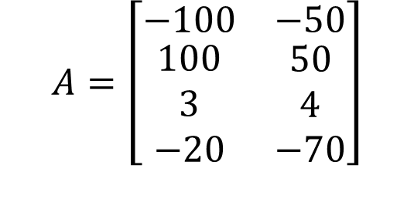
Solving an LP
But, how do we find the intersection between boundaries?
$$A=\left[\begin{matrix}−100 & −50 \\ \begin{aligned}100 \\ 3 \\ −20\end{aligned} & \begin{aligned}50 \\ 4 \\ −70\end{aligned}\end{matrix}\right]$$
$$b=\left[\begin{aligned}−2000 \\ 2500 \\ 100 \\ −700\end{aligned}\right]$$
Calorie min
$\min_{x}{ c^{T}x}$
s.t. $Ax⪯b$
Calorie max
Sugar
Calcium

Slide 18

Solving an LP
Solutions are at feasible intersections
of constraint boundaries!!
Algorithms
Check objective at all feasible intersections
Simplex

Slide 19
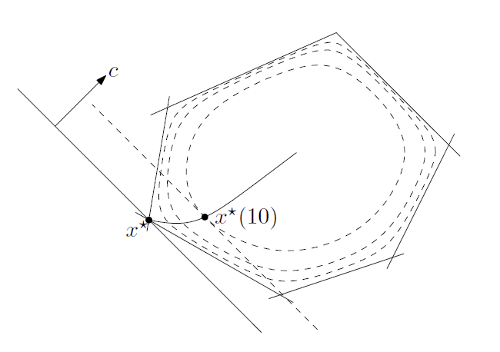

Solving an LP
Solutions are at feasible intersections
of constraint boundaries!!
Algorithms
Check objective at all feasible intersections
Simplex
Interior Point
Figure 11.2 from Boyd and Vandenberghe, Convex Optimization

Slide 20
What about higher dimensions?
Problem Description
Graphical Representation
Optimization Representation
$$\min_{x}{ c^{T}x}$$
s.t. $Ax⪯b$

Slide 21

“Marty, your not thinking fourth-dimensionally”

Slide 22
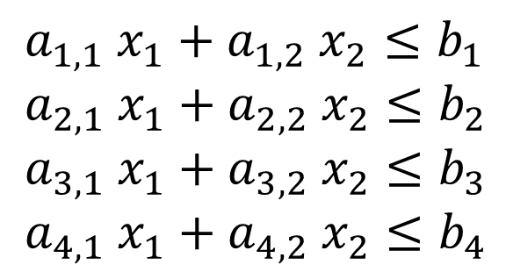

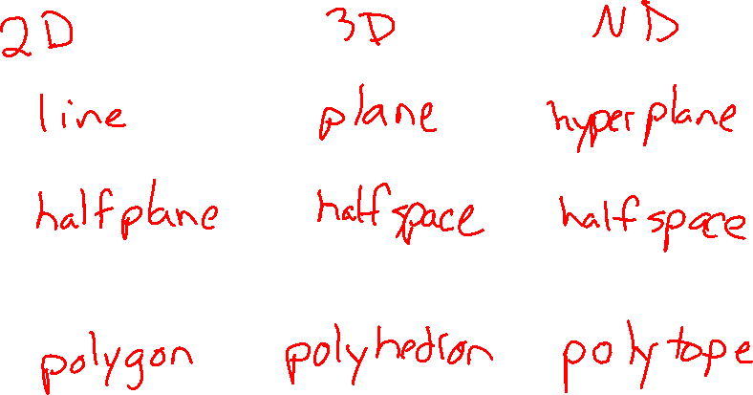

Shapes in higher dimensions
How do these linear shapes extend to 3-D, N-D?
$$a_{1} x_{1}+a_{2} x_{2}=b_{1}$$
$$a_{1} x_{1}+a_{2} x_{2}≤b_{1}$$
$a_{1,1} x_{1}+a_{1,2} x_{2}≤b_{1}$
$a_{2,1} x_{1}+a_{2,2} x_{2}≤b_{2}$
$a_{3,1} x_{1}+a_{3,2} x_{2}≤b_{3}$
$a_{4,1} x_{1}+a_{4,2} x_{2}≤b_{4}$

Slide 23



What are intersections in higher dimensions?
How do these linear shapes extend to 3-D, N-D?
$$A=\left[\begin{matrix}−100 & −50 \\ \begin{aligned}100 \\ 3 \\ −20\end{aligned} & \begin{aligned}50 \\ 4 \\ −70\end{aligned} \end{matrix}\right]$$
$$b=\left[\begin{aligned}−2000 \\ 2500 \\ 100 \\ −700\end{aligned}\right]$$
Calorie min
$\min_{x}{ c^{T}x}$
s.t. $Ax⪯b$
Calorie max
Sugar
Calcium

Slide 24


How do we find intersections in higher dimensions?
Still looking at subsets of $A$ matrix
$$A=\left[\begin{matrix}−100 & −50 \\ \begin{aligned}100 \\ 3 \\ −20\end{aligned} & \begin{aligned}50 \\ 4 \\ −70\end{aligned} \end{matrix}\right]$$
$$b=\left[\begin{aligned}−2000 \\ 2500 \\ 100 \\ −700\end{aligned}\right]$$
Calorie min
$\min_{x}{ c^{T}x}$
s.t. $Ax⪯b$
Calorie max
Sugar
Calcium

Slide 25
Linear Programming
We are trying healthy by finding the optimal amount of food to purchase.
We can choose the amount of stir-fry (ounce) and boba (fluid ounces).
Healthy Squad Goals
2000 $≤$ Calories $≤$ 2500
Sugar $≤$ 100 g
Calcium $≥$ 700 mg
Food | Cost | Calories | Sugar | Calcium
Stir-fry (per oz) | 1 | 100 | 3 | 20
Boba (per fl oz) | 0.5 | 50 | 4 | 70
What is the cheapest way to stay “healthy” with this menu?
How much stir-fry (ounce) and boba (fluid ounces) should we buy?

Slide 26
Linear Programming → Integer Programming
We are trying healthy by finding the optimal amount of food to purchase.
We can choose the amount of stir-fry (bowls) and boba (glasses).
Healthy Squad Goals
2000 $≤$ Calories $≤$ 2500
Sugar $≤$ 100 g
Calcium $≥$ 700 mg
Food | Cost | Calories | Sugar | Calcium
Stir-fry (per bowl) | 1 | 100 | 3 | 20
Boba (per glass) | 0.5 | 50 | 4 | 70
What is the cheapest way to stay “healthy” with this menu?
How much stir-fry (ounce) and boba (fluid ounces) should we buy?

Slide 27
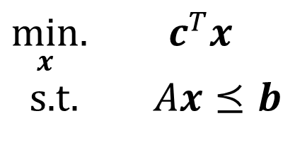
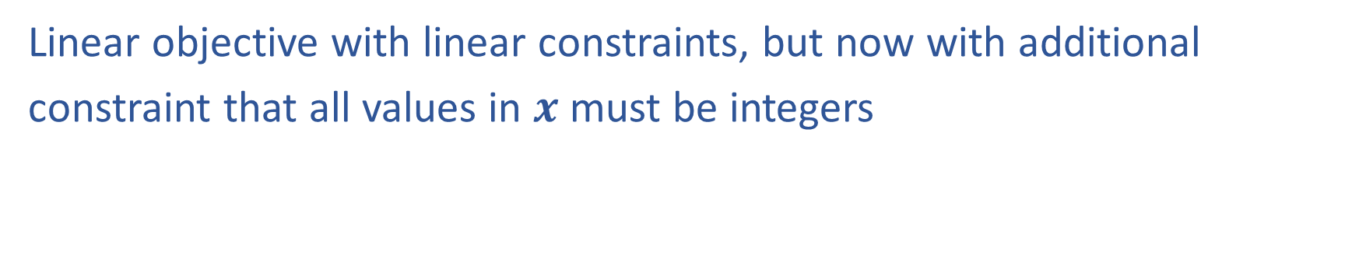

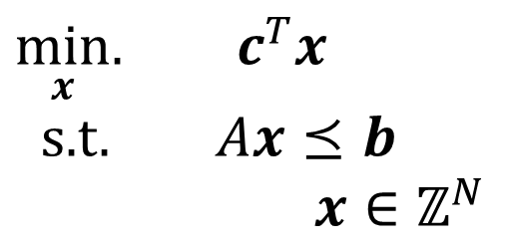
Linear Programming vs Integer Programming
Linear objective with linear constraints, but now with additional
constraint that all values in $x$ must be integers
$\min_{x}.{ c^{T}x}$
s.t. $Ax⪯b$
$\min_{x}.{ c^{T}x}$
s.t. $Ax⪯b$
$x∈ℤ^{N}$
We could also do:
Even more constrained: Binary Integer Programming
A hybrid: Mixed Integer Linear Programming
Notation Alert!

Slide 28

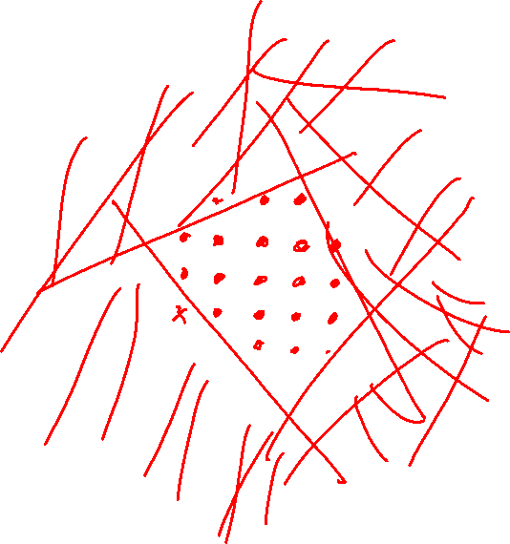
Integer Programming: Graphical Representation
Just add a grid of integer points onto our LP representation
$\min_{x}.{ c^{T}x}$
s.t. $Ax⪯b$
$x∈ℤ^{N}$

Slide 29
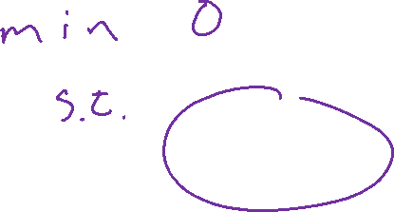
Integer Programming: Cryptarithmetic
How would we formulate this as a integer program?
How would we could we solve it?
Notes:
0=7, R=4, W=6, U=2, T=8, F=1; 867 + 867 = 1734

Slide 30
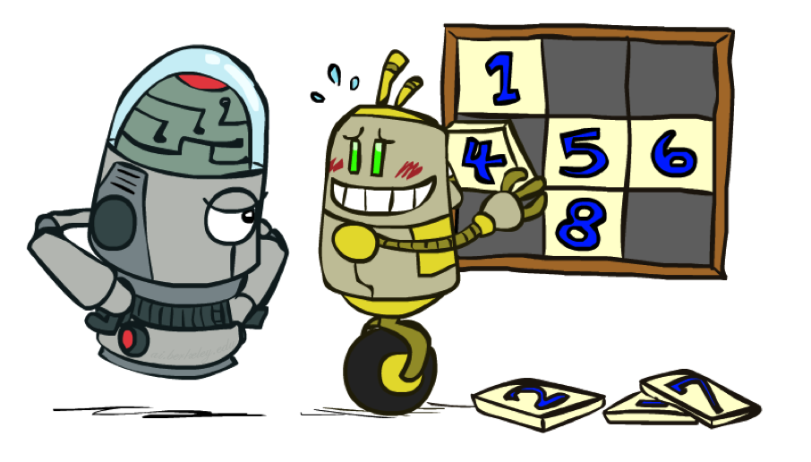
Relaxation
Relax IP to LP by dropping integer constraints
$\min_{x}.{ c^{T}x}$
s.t. $Ax⪯b$
$x∈ℤ^{N}$
Remember heuristics?

Slide 31
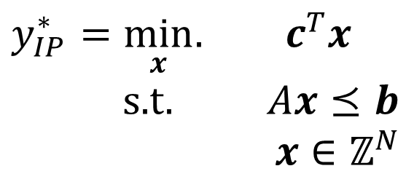
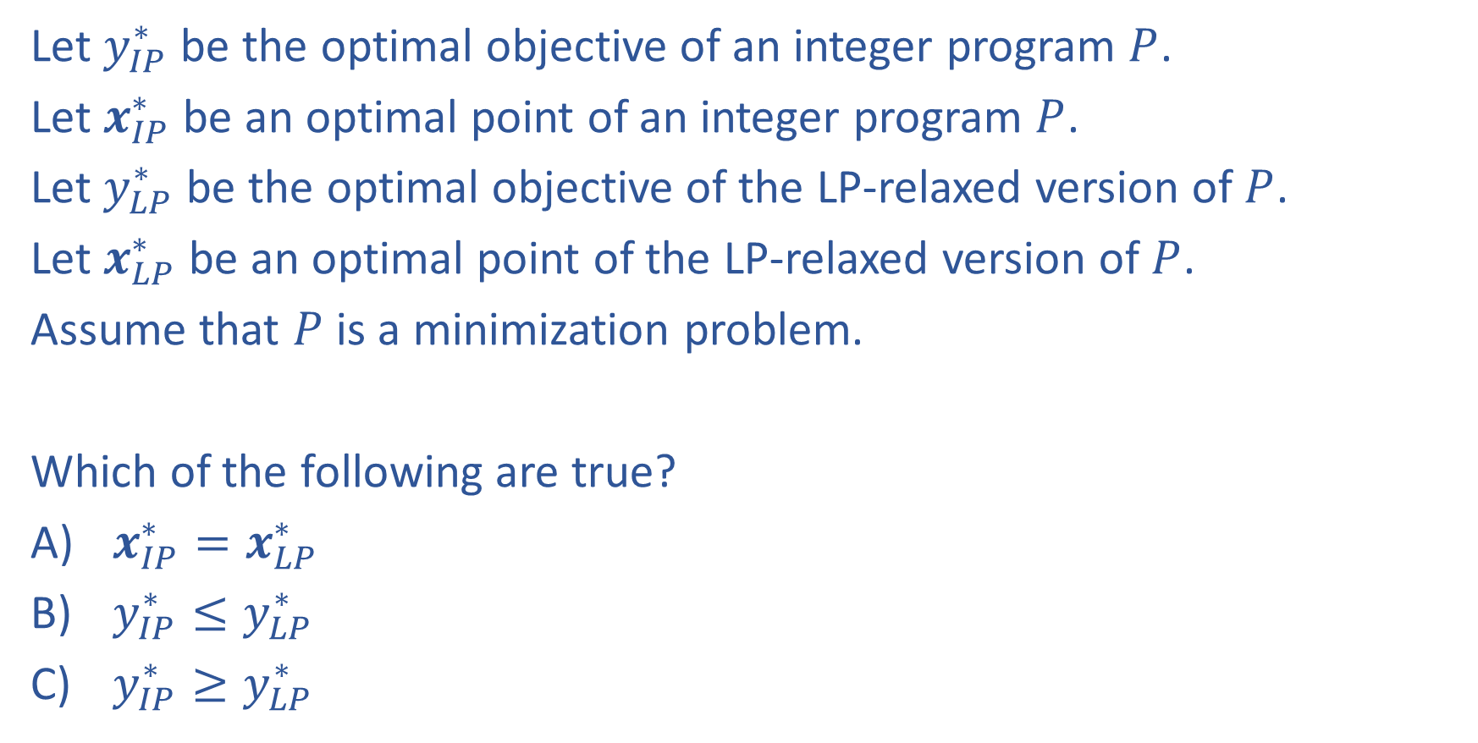
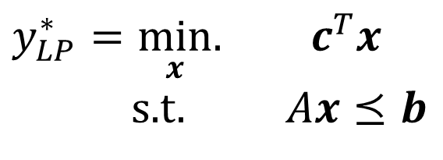
Piazza Poll 3:
Let $y_{IP}^{∗}$ be the optimal objective of an integer program $P$.
Let $x_{IP}^{∗}$ be an optimal point of an integer program $P$.
Let $y_{LP}^{∗}$ be the optimal objective of the LP-relaxed version of $P$.
Let $x_{LP}^{∗}$ be an optimal point of the LP-relaxed version of $P$.
Assume that $P$ is a minimization problem.
Which of the following are true?
$x_{IP}^{∗}=x_{LP}^{∗}$
$y_{IP}^{∗}≤y_{LP}^{∗}$
$y_{IP}^{∗}≥y_{LP}^{∗}$
$y_{IP}^{∗}=\min_{x}.{ c^{T}x}$
s.t. $Ax⪯b$
$x∈ℤ^{N}$
$y_{LP}^{∗}=\min_{x}.{ c^{T}x}$
s.t. $Ax⪯b$

Slide 32

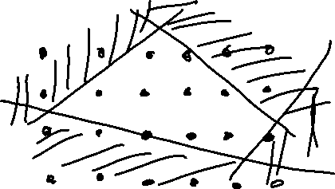

Piazza Poll 3:
Let $y_{IP}^{∗}$ be the optimal objective of an integer program $P$.
Let $x_{IP}^{∗}$ be an optimal point of an integer program $P$.
Let $y_{LP}^{∗}$ be the optimal objective of the LP-relaxed version of $P$.
Let $x_{LP}^{∗}$ be an optimal point of the LP-relaxed version of $P$.
Assume that $P$ is a minimization problem.
Which of the following are true?
$x_{IP}^{∗}=x_{LP}^{∗}$
$y_{IP}^{∗}≤y_{LP}^{∗}$
$y_{IP}^{∗}≥y_{LP}^{∗}$
$y_{IP}^{∗}=\min_{x}.{ c^{T}x}$
s.t. $Ax⪯b$
$x∈ℤ^{N}$
$y_{LP}^{∗}=\min_{x}.{ c^{T}x}$
s.t. $Ax⪯b$

Slide 33
Piazza Poll 4:
True/False: It is sufficient to consider the integer points around the corresponding LP solution.

Slide 34
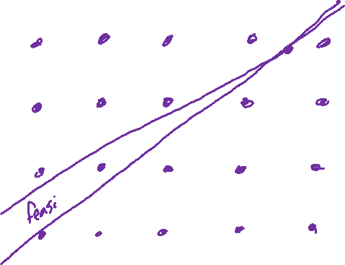

Piazza Poll 4:
True/False: It is sufficient to consider the integer points around the corresponding LP solution.

Slide 35
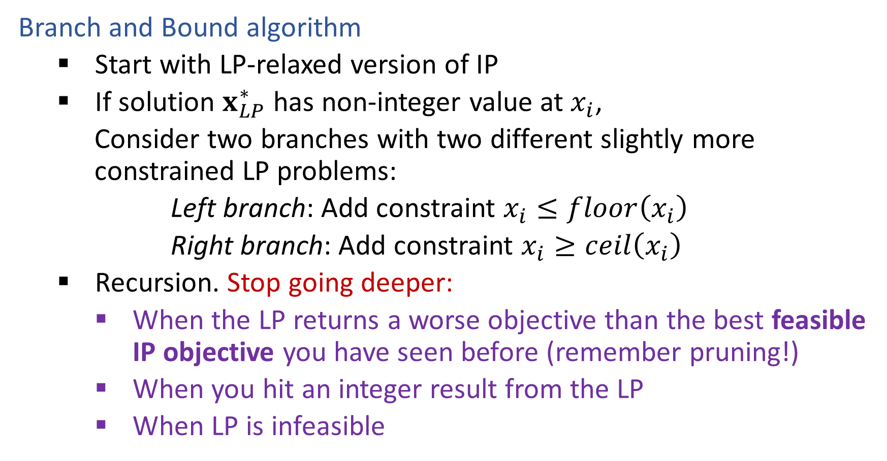
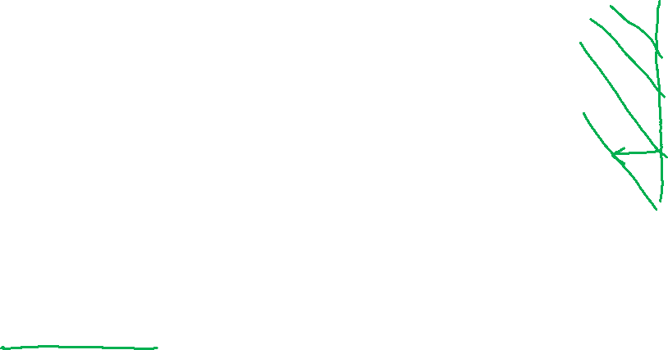
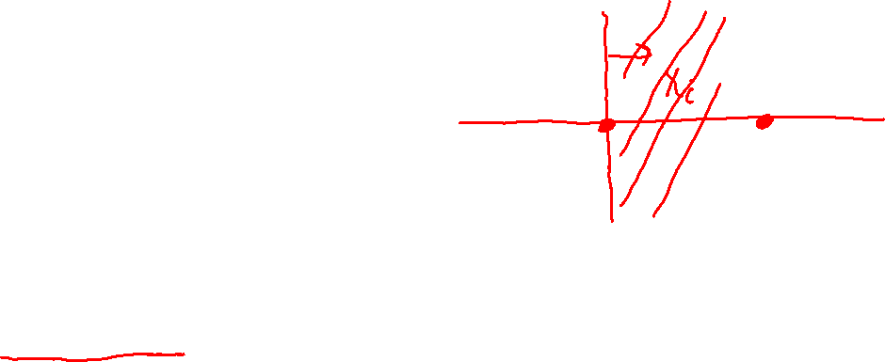
Solving an IP
Branch and Bound algorithm
Start with LP-relaxed version of IP
If solution $x_{LP}^{∗}$ has non-integer value at $x_{i}$,
Consider two branches with two different slightly more constrained LP problems:
Left branch: Add constraint $x_{i}≤floor\left(x_{i}\right)$
Right branch: Add constraint $x_{i}≥ceil\left(x_{i}\right)$
Recursion. Stop going deeper:
When the LP returns a worse objective than the best feasible IP objective you have seen before (remember pruning!)
When you hit an integer result from the LP
When LP is infeasible

Slide 36
Branch and Bound Example
15
10
5
10
15
20
25

Slide 37

Branch and Bound Example
15
10
5
10
15
20
25
15
15
10
10
5
5
10
15
20
25
10
15
20
25

